Slide 1
Review: ImageNet Classification with Deep Convolutional Neural Networks
Krizhevsky, Alex, Ilya Sutskever, and Geoffrey E. Hinton. "Imagenet classification with deep convolutional neural networks." Advances in neural information processing systems 25 (2012).

Slide 2
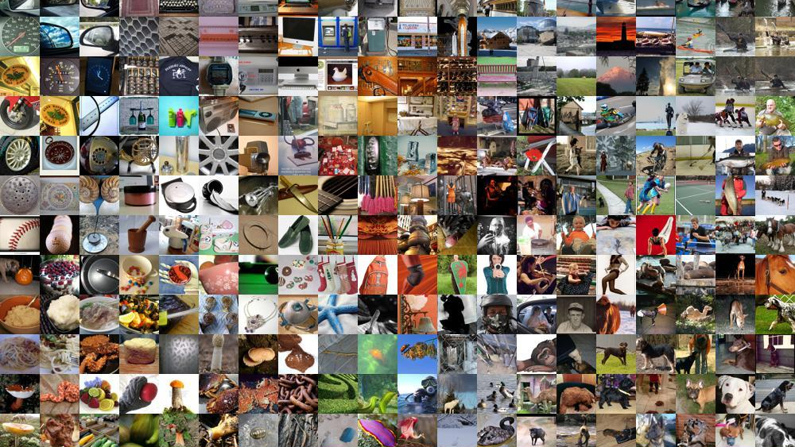
ImageNet
Fig.1.
Notes:
ImageNet is a dataset of over 15 million labeled high-resolution images belonging to roughly 22,000 differenct classes.

Slide 3
Benchmark
ImageNet Large-Scale Visual Recognition Challenge (ILSVRC)
Notes:
Since 2010 the dataset is used in the ImageNet Large Scale Visual Recognition Challenge (ILSVRC), a benchmark in image classification and object detection. The publicly released dataset contains a set of manually annotated training image.

Slide 4
Performance Metric
Top-1-score: if a sample’s top class is the same as its target label
Top-5-score: if target label is in the 5 highest predictions
Top-1-error: fraction of test images where the correct label is not the most probable predicted by the model.
Top-5-error: fraction of test images where the correct label is not among the five labels considered most probable by the model.
Notes:
On ImageNet, it is customary to report two scores and also its error rates: top-1 and top-5.
Where the top-5 error rate is the fraction of test images for which the correct label is not among the five labels considered most probable by the model.

Slide 5
Main Contributions
Outperformed results on the subsets of ImageNet
Accelerated Training
New Features for increased performance
Techniques to prevent overfitting
Particular Design choices
five convolutional and three fully-connected layers
Notes:
ILSVRC-2010 and ILSVRC-2012
Competitions

Slide 6
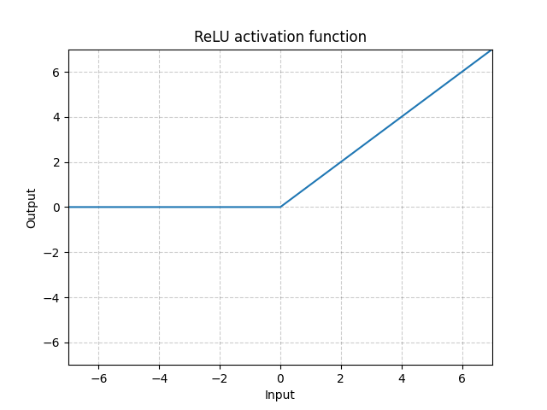
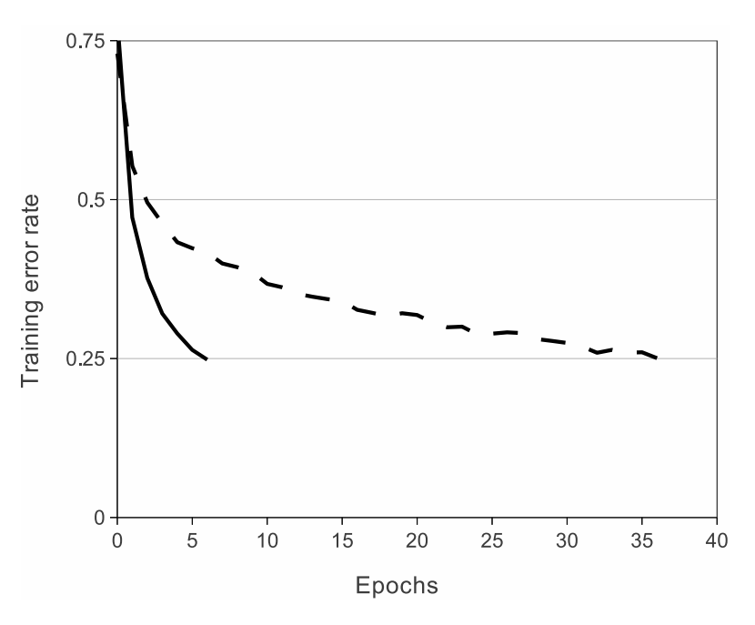


Activation Function
Rectified Linear Units (ReLUs)
$$f\left(z\right)=\max\left(0, z\right)$$
Fig.2a.
Faster than
$$f\left(z\right)=\tanh\left(z\right)$$
Fig.2b.
Notes:
They use the RELU activation function which is 0 zero for all negative values and increasing in all positive. This is targeting the vanishing gradient problem that occurs with other activation functions such as sigmoid, where gradients tend to saturate
They show that a four-layer convolutional neural
network with ReLUs (solid line) reaches a 25%
training error rate on CIFAR-10 six times faster
than an equivalent network with tanh neurons(dashed line).
They show that deep convolutional neural net-works with ReLUs train several times faster than their equivalents with other activation function like tanh units. .
Faster learning has a great influence on the performance of large models trained on large datasets.
equivalents with tanh units.
(dashed line).

Slide 7
Training on Multiple GPUs
Spread net across two GPUs.
Half of the kernels per GPU
communication limited to certain layers

Slide 8
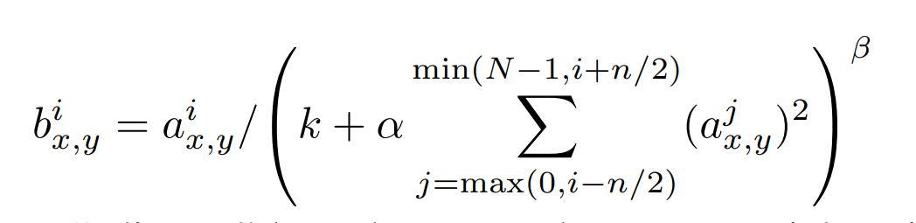
Local Response Normalization
local normalization scheme aids generalization
- Sum runs Over n adjacent kernel maps at the same spatial position
- For N number of kernels in the layer
Notes:
This layer is useful when we are dealing with ReLU neurons.
Why is that? Because ReLU neurons have unbounded activations and we need LRN to normalize that.
We applied this normalization after applying the ReLU nonlinearity in certain layers. If all the values are large, then normalizing those values will diminish all of them. So basically we want to encourage some kind of inhibition and boost the neurons with relatively larger activations.
When you are normalizing within the same channel, it’s just like considering a 2D neighborhood of dimension N x N, where N is the size of the normalization window. You normalize this window using the values in this neighborhood. If you are normalizing across channels, you will consider a neighborhood along the third dimension but at a single location
We want to detect high frequency features with a large response. If we normalize around the local neighborhood of the excited neuron, it becomes even more sensitive as compared to its neighbors. At the same time, it will dampen the responses that are uniformly large in any given local neighborhood. If all the values are large, then normalizing those values will diminish all of them. So basically we want to encourage some kind of inhibition and boost the neurons with relatively larger activations.

Slide 9
Overlapping Pooling
Pooling
3 | 1 | 3 | 5
6 | 0 | 7 | 9
3 | 2 | 1 | 4
0 | 2 | 4 | 3
6 | 9
3 | 4
Max-Pool with
Stride 2
2x2 max pooling
3 | 1 | 3 | 5
6 | 0 | 7 | 9
3 | 2 | 1 | 4
0 | 2 | 4 | 3
Overlapping pooling
7 | 9
7 | 9
Stride 2
3x3 max pooling
Notes:
Traditionally, the neighborhoods summarized by adjacent pooling units do not overlap.
grid of pooling units spaced s pixels apart, each summarizing a neighborhood of size z × z centered at the location of the pooling unit.
In this case they were setting the stride to smaller than the size of the filter kernel.
This scheme reduces the top-1 and top-5 error rates by 0.4% and 0.3%, respectively, as compared with the non-overlapping scheme s = 2, z = 2, which produces output of equivalent dimensions.

Slide 10
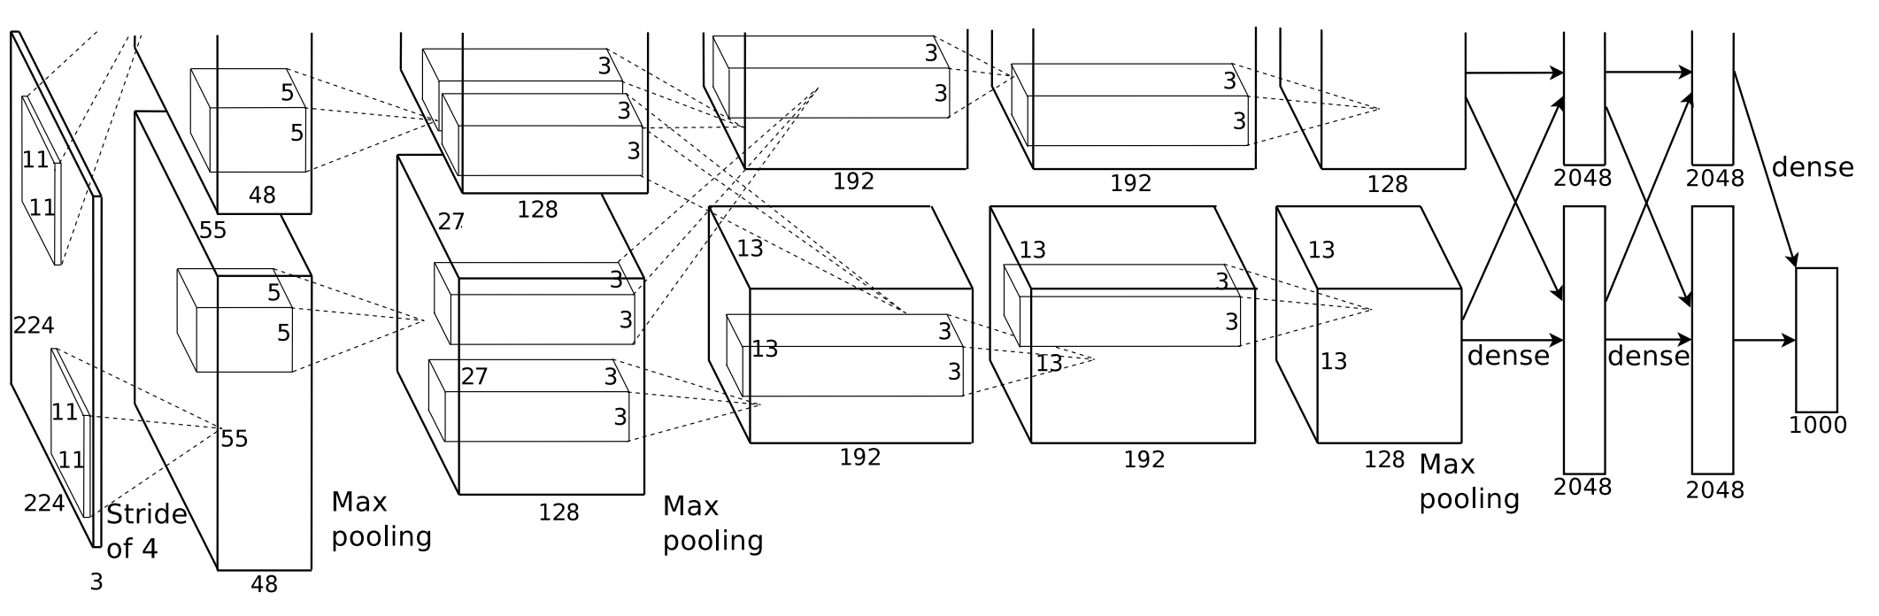
Model Architecture
Decreased width and height
Augment the depth of the activation maps
Notes:
Revolutionized the field of computervision by showing that CNNs were actually applicable and giving good results by cutting the error on imagenet by half.
Due to the gpus not being really powerful unlike right now.
So this architecture worked directly with the RGB images, so larger images of 227x227 and a depth of 3.
This network architecture started of with a pretty aggressive spatial reduction from the very beginning. So you can see that we start with a pretty large filter of 11x11 and a stride of 4 and with only one convolution we reduce it to 55 by 55, using such big filters and stride of 4 is not really common anymore.
So the goal As with the predecessor LeNet: Width and Height is reduced so the spatial resolution and augment the depth of the activation maps – number of filters.

Slide 11
Model Architecture
Notes:
So we see extrem reductions at the beginning, which is then followed by a series of smaller convolutions 3x3 (same convolutions) that are kinda refining these features, until we reach our final representation of 6x6x256.

Slide 12
Model Architecture
Fig.3.
Softmax for 1000 classes
Notes:
Now after that we need to map that representation into the number of classes of imagenet. So again here we are going to use a series of fully connected layers to shape this features into the number of actual output that we need to deal with that particular dataset.
Softmax for a 1000 classes. Model is bigger.
60 Million parameters.
Particular design choices to deal with such a huge dataset.

Slide 13
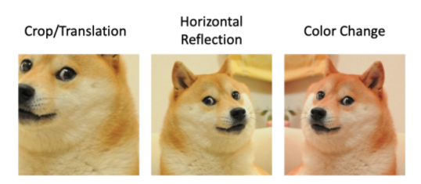
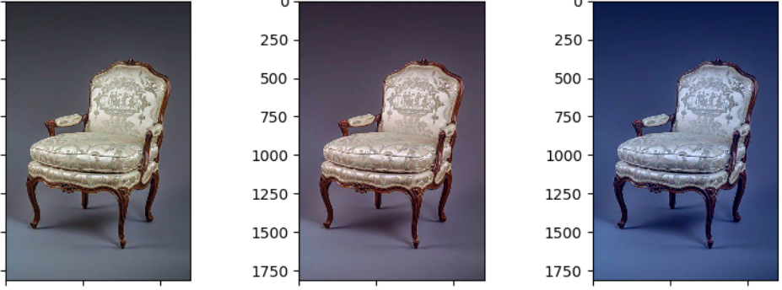
Data Augmentation
Extraction of random patches
Horizontal reflections
Fig.4.
Colour change
Fig.5.
Notes:
Data-pre-processing
Using transformation that preserve the label
They also mention that the data augmentation performed on cpu
They use PCA color augmentation to alter the intensities of the RGB channels along the natural variations of the images, denoted by the principal components of the pixel colors. This generates particularly natural views on the same instances compared to random changes in RGB intensities.
Issue: high interdependence of data
At test time, the network makes a prediction by extracting
five 224 × 224 patches (the four corner patches and the center patch) as well as their horizontal
reflections (hence ten patches in all), and averaging the predictions made by the network’s softmax
layer on the ten patches.

Slide 14
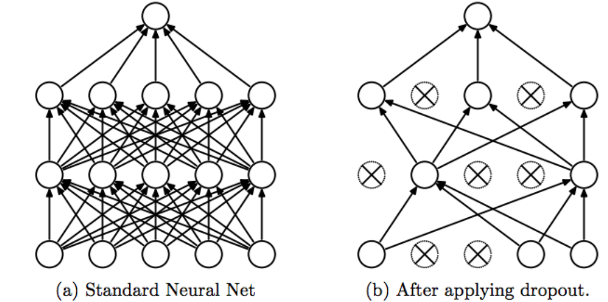
Dropout
Disable a random set of neurons (dropout probability p = 0.5)
Fig.6.
Notes:
Bagging – train multiple models and average their results
Use different training sets and specialize into different things
Dropout is a regularization technique proposed in 2015 where you would train a standard neural network and at some point you would disable a random set of neurons. During the forward pass 50 percents are disabled. Nodes with crosses are not used in forward pass. We actually reduce the capacity, half capacity, half expressiveness.
Intuition. Nodes learn certain characteristics. Suddenly you ignore half of them. Neural Network is no longer able to detect the result with much less information. During the backword pass you will reprogram the active neurons that are able to help with the detecitons. – Some sort of redundant representations.
The way it is done is that every time the network is trained on a different mini – patch but with shared parameters.
Conditions at training and test times are diffent

Slide 15
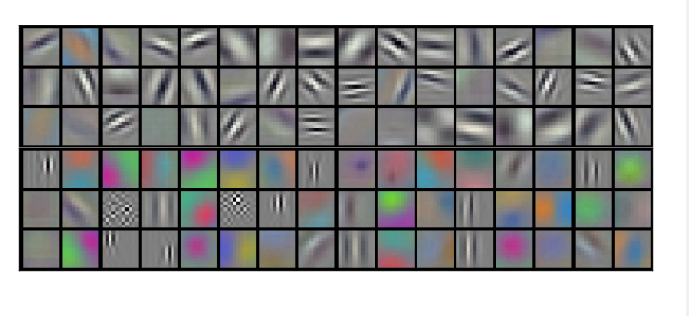
Training
Stochastic Gradient Descent
Weight initialization with zero mean gaussian, variance 0.01
Fig.7.
Notes:
with a batch size of 128 examples, momentum of 0.9, and weight decay of 0.0005
We initialized the neuron biases in the second, fourth, and fifth convolutional layers, as well as in the fully-connected hidden layers, with the constant 1. This initialization accelerates the early stages of learning by providing the ReLUs with positive inputs. We initialized the neuron biases in the remaining layers with the constant 0.
The heuristic which we followed was to divide the learning rate by 10 when the validation error rate stopped improving with the current learning rate. The learning rate was initialized at 0.01 and 6 reduced three times prior to termination
Figure features learned by the first layer (above gpu1, bottom gpu 2). Interestingly The kernels on GPU 1 are largely color-agnostic, while the kernels on on GPU 2 are largely color-specific

Slide 16
Impact
Multiple GPU | 1.7% top-1-error | 1.2 % top-5-error
Local Response Normalization | 1.4% top-1-error | 1.2% top-5-error
Data Augmentation | 1.0% top-1-error
Dropout | overfitting | time

Slide 17
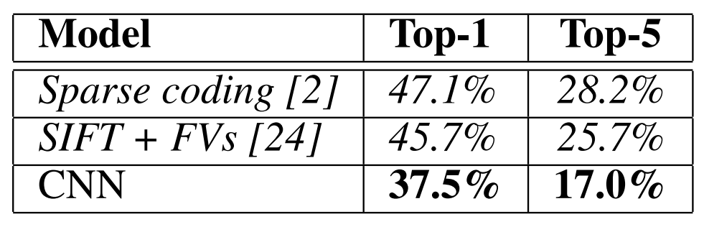
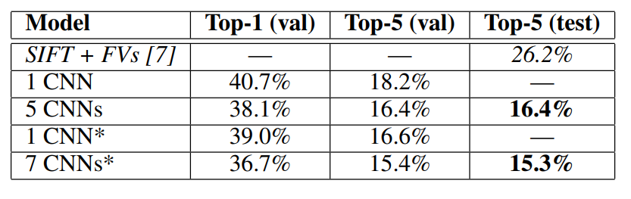
Results
On ILSVRC2010
On ILSVRC2012
Notes:
validation and test error rates interchangeably because in our experience they do not differ by more than 0.1%
AlexNet network achieves top-1 and top-5 test set error rates of 37.5% and 17.0%.
Some extra fine-tuning on new release. To produce the last result they were averaging the predictions of two CNNS.
The CNN described in this paper achieves a top-5 error rate of 18.2%

Slide 18
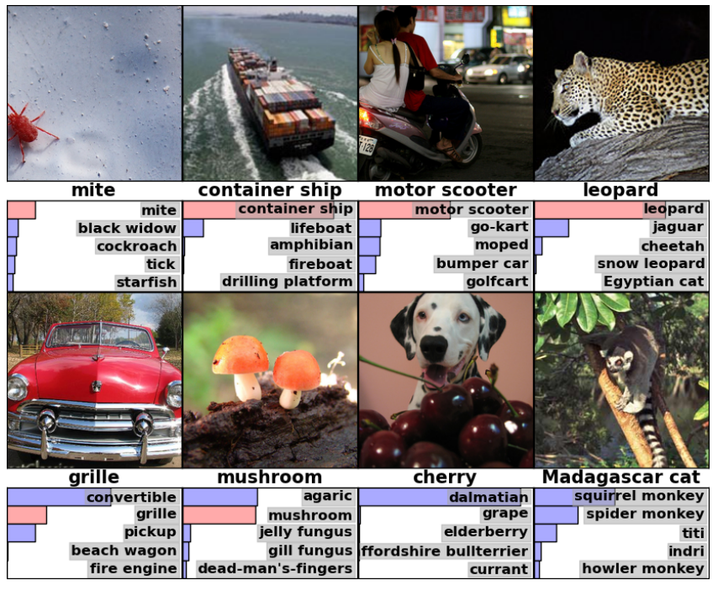
Results
Notes:
we qualitatively assess what the network has learned by computing its top-5 predictions on eight test images. only other types of cat are considered plausible labels for the leopard.

Slide 19
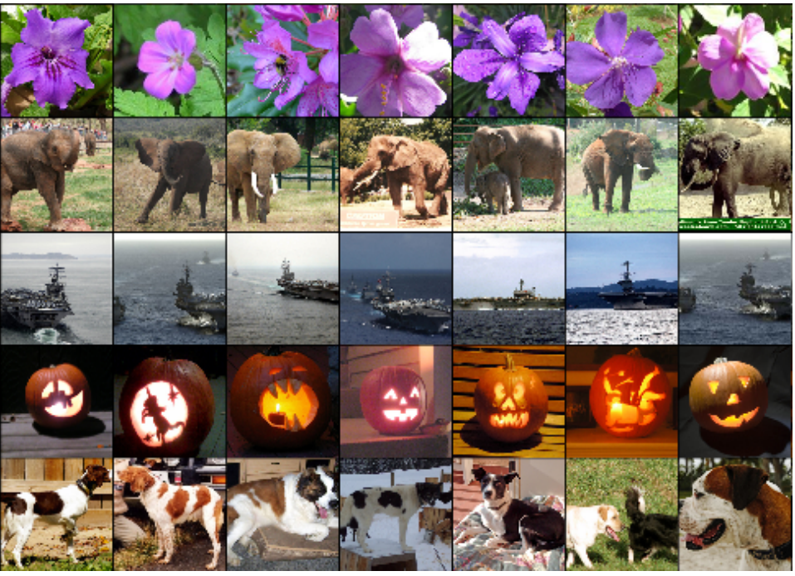
Similarity in Feature Space
Notes:
show the six training images that produce feature vectors in the last hidden layer with the smallest Euclidean distance from the feature vector for the test image.
If two images produce feature activation vectors with a small Euclidean separation, we can say that the higher levels of the neural network consider them to be similar..

Slide 20
Verdict
Really important architecture in the history of deep learning for computer vision
Great results however did not outperform human annotation at that time (no superpowers)
A lot of early findings and directions

Slide 21
Sources
Fig. 1. https://paperswithcode.com/dataset/imagenet (accessed 12.03.2022)
Fig. 2. https://machinelearningmastery.com/rectified-linear-activation-function-for-deep-learning-neural-networks/ (accessed 12.03.2022)
Fig. 3 + 7 + 8 + 9 + all tables. Krizhevsky, Alex, Ilya Sutskever, and Geoffrey E. Hinton. "Imagenet classification with deep convolutional neural networks." Advances in neural information processing systems 25 (2012).
Fig. 4. https://notrocketscience.blog/complete-guide-to-data-augmentation-for-computer-vision/ (accessed 12.03.2022)
Fig. 5. https://aparico.github.io/ (accessed 12.03.2022)
Fig. 6. https://medium.com/@amarbudhiraja/https-medium-com-amarbudhiraja-learning-less-to-learn-better-dropout-in-deep-machine-learning-74334da4bfc5 (accessed 12.03.2022)

